Slide 1
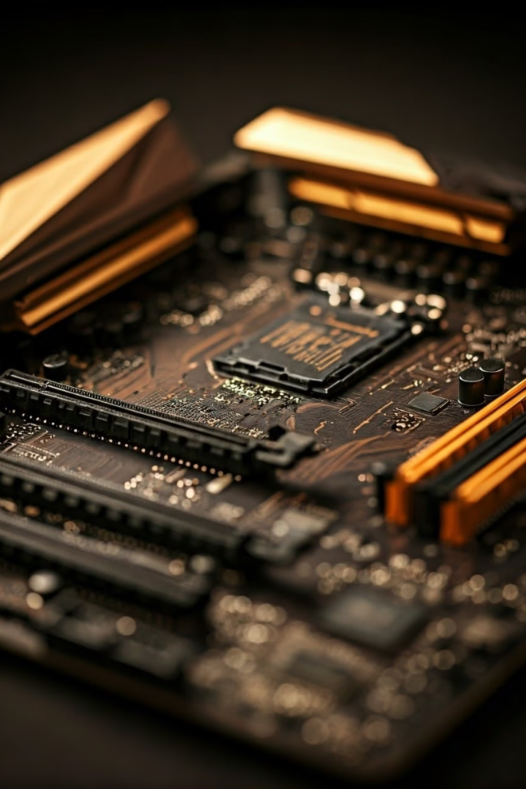
Computer Organization and Architecture: Performance

Slide 2
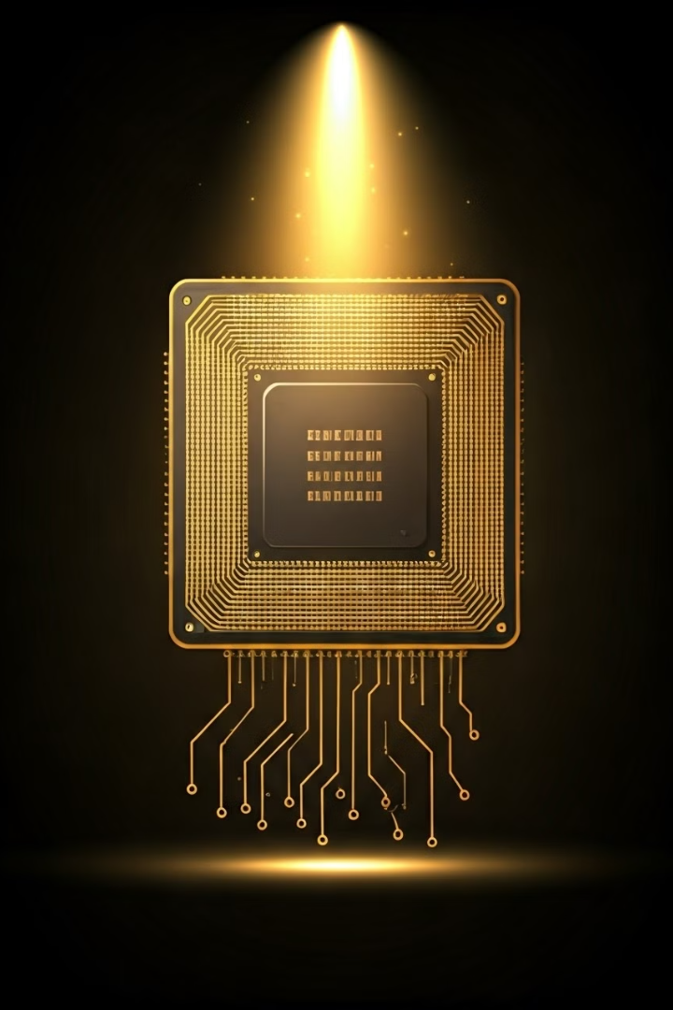
Processor Design and Microarchitecture
1
Core Components
2
Instruction Fetch and Decode
The CPU, the brain of the computer, consists of key components like the ALU, control unit, and registers, which work together to execute instructions.
The CPU fetches instructions from memory, decodes them, and executes them in a precise sequence, forming the basis of computer operation.
3
Pipeline Architecture
4
Microarchitecture Design
Pipelining allows the CPU to process multiple instructions concurrently, enhancing overall performance by overlapping different stages of instruction execution.
Modern CPUs utilize advanced microarchitecture techniques like superscalar execution, branch prediction, and out-of-order execution to further improve efficiency and speed.

Slide 3
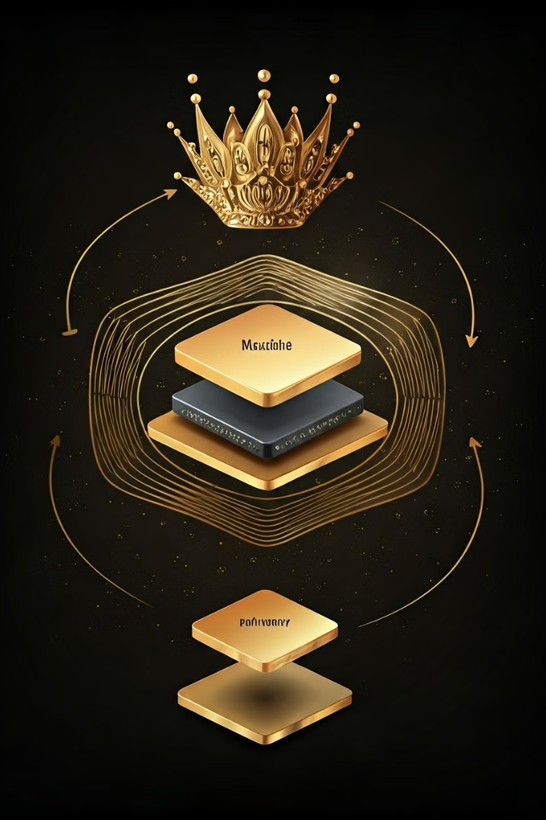
Memory Hierarchy and Performance
1
Cache Memory
Small, fast memory that stores frequently accessed data to reduce access time to main memory.
2
Main Memory
Larger, slower memory that stores the currently running program and data, acting as a primary storage location.
3
Secondary Storage
Large, permanent storage devices like hard drives or SSDs, used for storing files and programs not currently in use.

Slide 4
Input/Output and Peripheral Devices
Input Devices
Output Devices
Peripheral Interfaces
Keyboard, mouse, scanner, microphone, webcam, and other devices that allow users to input data and commands into the computer.
Monitor, printer, speakers, and other devices that display or output processed data, information, and results from the computer.
Busses, controllers, and drivers that facilitate communication and data transfer between the CPU and peripheral devices, ensuring smooth operation.

Slide 5




Instruction Set Architecture and Assembly Language
Instruction Set Architecture
Defines the set of instructions that a processor can understand and execute, forming the foundation of the computer's programming language.
Assembly Language
Low-level programming language that uses mnemonic codes to represent machine instructions, providing a more readable representation than binary code.
Instruction Encoding
Instructions are encoded in binary format, which the processor interprets and executes based on the defined instruction set architecture.

Slide 6
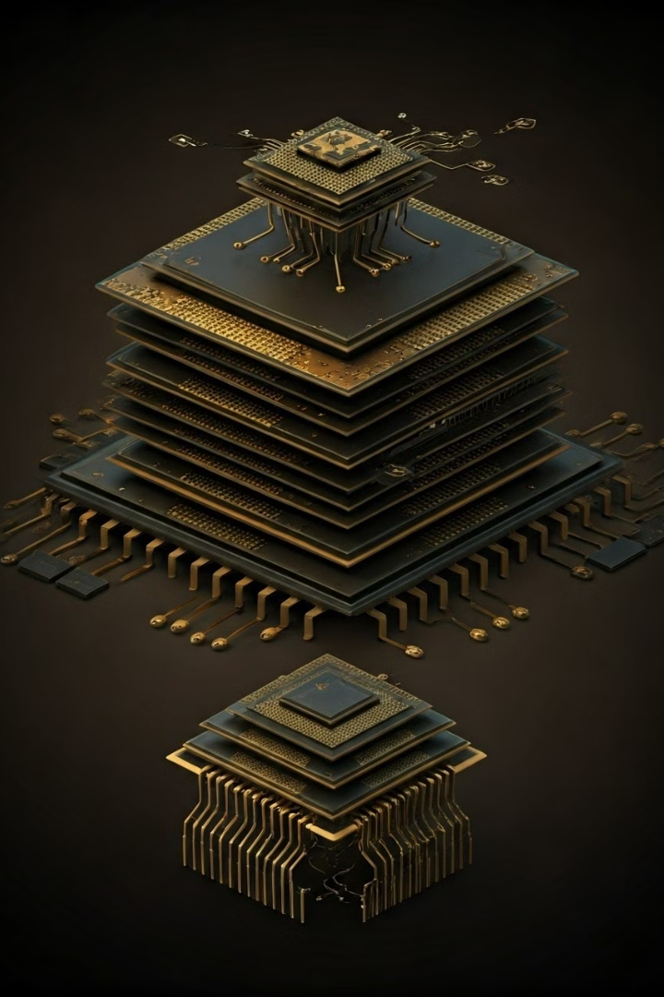
Pipelining and Parallelism
Pipelining
Technique that breaks down instruction execution into multiple stages, allowing multiple instructions to be processed concurrently, enhancing throughput and performance.
Parallelism
Utilizing multiple processing units or cores to execute instructions simultaneously, achieving significant performance gains in computationally intensive tasks.
Multithreading
Technique that allows multiple threads of execution to run concurrently on a single processor core, enhancing resource utilization and improving responsiveness.

Slide 7
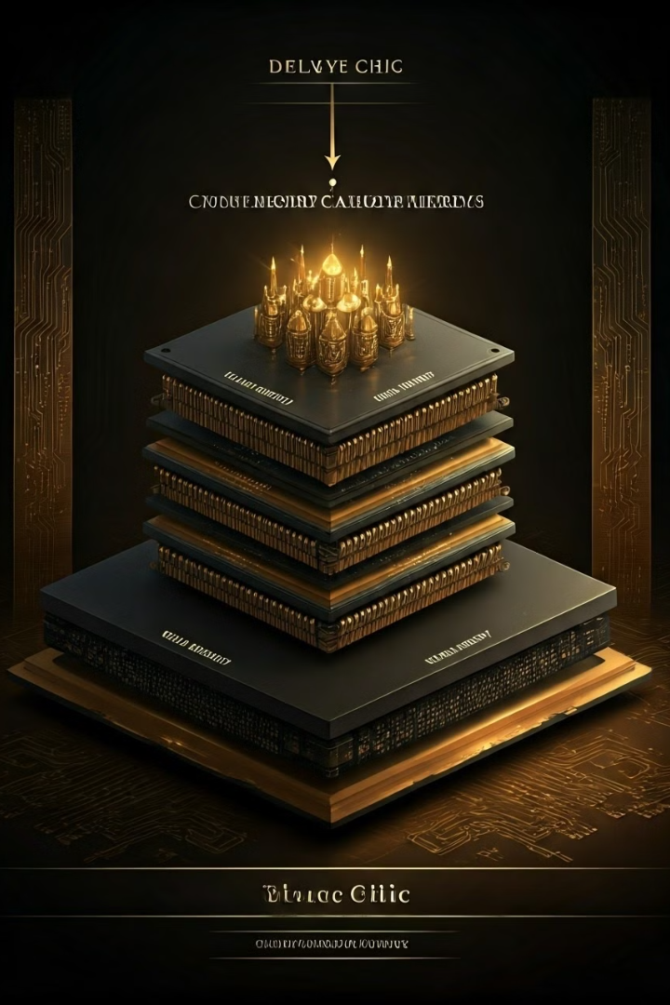
Cache and Virtual Memory Management
Cache Memory
Virtual Memory
Small, fast memory that stores frequently accessed data, reducing the need to access slower main memory, thereby improving performance.
Technique that allows programs to access more memory than physically available by using disk space as an extension of RAM, enabling execution of larger programs.
Page Replacement Algorithms
Algorithms used to manage the swapping of pages between main memory and disk storage, ensuring efficient memory allocation and data access.

Slide 8
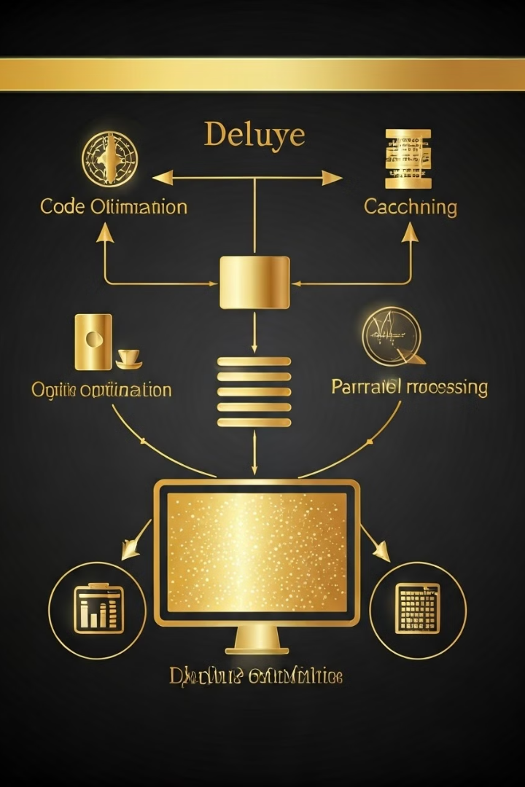




Performance Optimization Techniques
Code Optimization
Cache Optimization
Techniques that improve the efficiency of program code by reducing redundant computations, minimizing memory access, and enhancing instruction scheduling.
Strategies that enhance the effectiveness of the cache memory system, ensuring that frequently accessed data is readily available for quick retrieval, reducing access times.
Memory Management
Parallel Processing
Techniques that effectively allocate and manage computer memory, ensuring efficient utilization of resources and preventing memory leaks or fragmentation.
Utilizing multiple processors or cores to execute instructions concurrently, significantly enhancing performance for computationally intensive tasks.

